Slide 1
Integrals
Eric Prebys

Slide 2
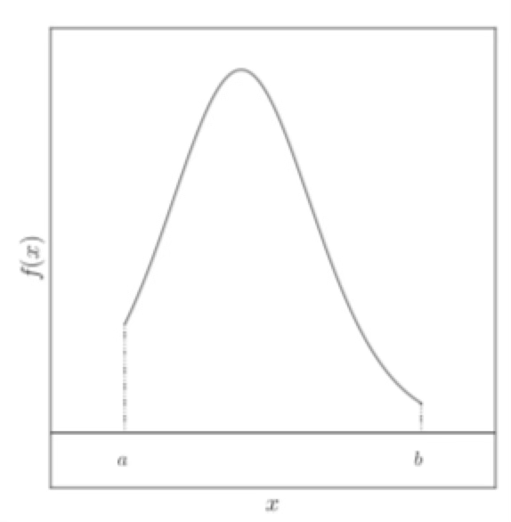
General Problem
Reduce an integral to a discrete sums
Start with n discrete points
Approximate as a sum

Slide 3
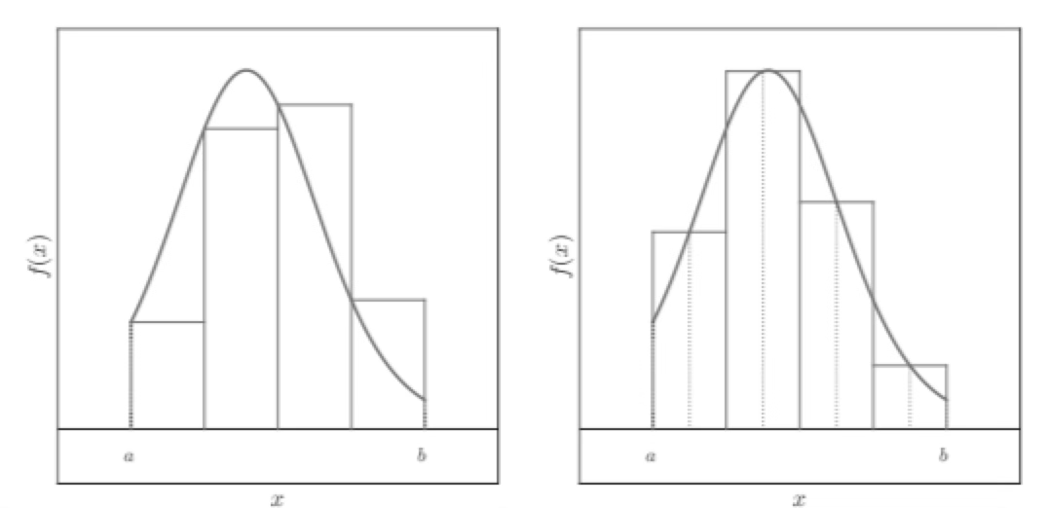
Left-side Rule Integrals
The simplest
Skip last point

Slide 4
Error on Left-side Rule
If we Taylor expand about the starting point

Slide 5
Midpoint Rule
We can obviously do better if we use the midpoint

Slide 6
Tra

